Slide 1

Global NPS® Benchmark 2023

Slide 2


Introduction
Smoke CI are delighted to present the findings of our comprehensive study on the 2022 Net Promote® Score (NPS ®) benchmark across diverse industries and journey touchpoints.
Our analysis involved three main survey methodologies: Interactive Voice Recording (IVR), Short Message Service (SMS), and online surveys. The scope of our study encompassed a wide range of clients, industries, and journey touchpoints, providing a holistic overview of NPS performance. It is important to highlight that, except for 3 sets of results, all data were recorded in 2022, with a total of 2,832,966 results meticulously analysed.
Our study revealed that the average NPS benchmark across the surveyed industries and journey touchpoints in 2022 was 43.03. This benchmark is a crucial reference point for assessing the likelihood of customer recommendations within these sectors. However, we must emphasize that NPS scores can vary significantly across industries and companies. Therefore, when interpreting this score, it is imperative to consider the specific industry context and competitors' performance.
We trust that you will find value in our benchmarking results and use them to further expand and improve on your customer experience programmes within your industry.
If you do build a great experience, customers tell each other about that.
~Jeff Bezos

Slide 3
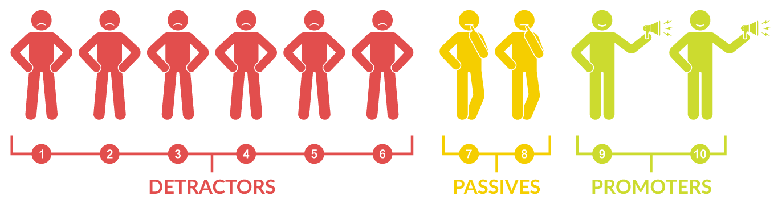
Definitions
What is an NPS Score?
Net Promoter ® Score
NPS = % Promoters - % Detractors
An NPS® Score is a metric used to measure a customer’s willingness to recommend a business to a friend or acquaintance, typified by the question:
“On a scale of 0 to 10, how likely are you to recommend our company/product/service to a friend or colleague?“

Slide 4

NPS® PROS
NPS® CONS
Simplicity
Actionable insights
Predictive value
Comparative benchmarking
Customer-centric
Limited scope
Oversimplification
Bias
Lack of context
Inability to capture non-response

Slide 5

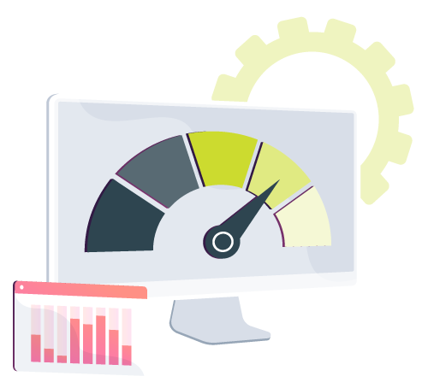
Definitions
What is a Benchmark?
A reference point used to evaluate the performance of a company or organisation.
A benchmark represents the average NPS® score for a specific industry or market segment.
By comparing their NPS® score to the benchmark, companies can gain insights into how well they perform relative to their competitors or peers.
5

Slide 6
NPS® PROS
NPS® CONS
Comparison
Goal-setting
Competitive analysis
Limited context
Industry differences
Variations in methodology

Slide 7
Benchmark Study
Methodology
The following benchmark study intends to examine the 2022 NPS® across various industries and journey touchpoints using the three main survey methodologies; IVR, SMS and online.
ASSUMPTIONS:
All* (apart from 3 sets of results) were recorded in 2022 and no analysis was done on samples of less than 100 with 2 832 966 results analysed in total.
Average NPS® benchmark was 43.
INDUSTRIES:
Banking
Financial Services/Insurance
Healthcare Providers and Subsidiaries
Business Process Outsourcing
Housing/Property
Telecommunications
7

Slide 8
Noteworthy
As with any kind of analysis, there will be nuances in being able to compare fully and completely “like for like”. Therefore, the following aspects need to be taken into consideration:
Rating Scales: Although the standard metric for NPS® measurement, some clients require bespoke rating scales. Consequently, some questions that were analysed used scales of 1 to 5 and 1 to 10, as well as the standard NPS® 0 to 10. In order to compare these as accurately as possible, the 1 to 5 and 1 and 10 scales were converted to 0 to 10. In addition, the 1 to 5 and 1 to 10 scale results may be inflated due to the absence of an absolute zero.
The most exciting phrase to hear in science, the one that heralds new discoveries, is not ‘Eureka!’ but ‘That’s funny…”
~Isaac Asimov

Slide 9

Benchmark By Industry

Slide 10







Results Overview

Slide 11



Banking Service: Relationship-focused
Findings: The banking industry boasts an NPS® benchmark of 74.71, with 84.46% of customers inclined to promote their bank to others.
Banks with an NPS of 74.71 or above are positioned favourably within the industry, showing their ability to meet customer expectations and deliver high levels of service.
74.71
Nice to Know:
According to a study by Bain & Company, banks with high NPS scores grow their deposits at more than twice the rate of banks with lower NPS scores.
Sample Size = 182 198
2022 Overall NPS® Benchmark: 43.03%

Slide 12
Property Service: Relationship-focused
Findings: Given the long-term nature of property transactions and management, an NPS® benchmark of 71.45 implies that companies emphasise relationship-building and provide personalised services to their clients.
71.45
Nice to Know:
Studies have shown that referrals from satisfied customers can be a powerful driver of new business in the real estate and property sectors.
Sample Size = 254 590
2022 Overall NPS® Benchmark: 43.03%

Slide 13
Insurance
Service: Low-touch
Findings:
The Insurance industry has an NPS® benchmark of 62.67, with the percentage of promoters being significantly higher than the percentage of detractors
62.67
Nice to Know:
Research conducted by Medallia reveals that insurance companies with a high NPS have notably lower customer churn rates in comparison to those with a lower NPS.
Sample Size = 225 706
2022 Overall NPS® Benchmark: 43.03%

Slide 14
Logistics Service: Delivery
Findings: An NPS® benchmark of 55.08 suggests that customers in the Logistics industry have a positive perception of the services they receive. In today's era of rapid technological advancement, logistics companies that embrace cutting-edge technology such as digital solutions, automation, real-time tracking, and data analytics can enhance their services and deliver an improved customer experience.
55.08
Nice to Know:
Given the competitive nature of the logistics industry, where multiple providers offer similar services, having a strong NPS® and a base of loyal, satisfied customers can give a logistics company a significant competitive advantage.
Sample Size = 14 609
2022 Overall NPS® Benchmark: 43.03%

Slide 15

BPO Service: Outsourced
Findings: An NPS® benchmark of 49.42 indicates that a significant portion of BPO customers have a positive perception of the company and its services. An above-average NPS® benchmark could be a result of the challenge the BPO Industry faces in dealing with and maintaining third-party customer experiences.
49.42
Nice to Know:
A study conducted by HFS Research showed that BPO providers with a higher NPS® had better upsell and cross-sell opportunities with existing clients.
Sample Size = 114 862
2022 Overall NPS® Benchmark: 43.03%

Slide 16
Healthcare Service: High-stakes Based
Findings: In Healthcare, patient experience is much bigger than the company's bottom line, it's critical for patient well-being.
Owing to Healthcare being an extremely personal service, there is a higher service expectation and individuals prioritise different factors based on their unique needs and preferences, resulting in varied NPS responses.
36.42
Nice to Know:
When patients choose a healthcare provider, they’re signing up for a consistent service rather than a once-off experience. Thus, by leveraging an above-average Net Promoter ® Score, healthcare companies can attract and retain patients more effectively.
Sample Size = 18 089
2022 Overall NPS Benchmark: 43.03%

Slide 17
Telecoms Service: Utility / Commodity
FINDINGS: While an NPS® benchmark of 34.01 indicates some level of customer satisfaction, there is significant room for improvement to enhance customer experience.
Telecom companies face challenges in differentiating their services, attracting and retaining customers, and staying ahead of competitors in terms of pricing, network coverage, and service quality.
34.01
NICE TO KNOW:
Telecom companies that prioritise customer satisfaction, engagement, and loyalty, as reflected by a high NPS®, are more likely to thrive in a highly competitive market and achieve sustainable growth.
Sample Size = 2 022 912
2022 Overall NPS® Benchmark: 43.03%

Slide 18
NPS® By Touchpoint
Onboarding: Most customers are promoters as the company ensures a smooth transition from the initial purchase to a satisfied and engaged customer.
Contact Centre: High level of promoters as customers are generally less inclined to provide low ratings when evaluating a person rather than an impersonal process.
Cancellations: Majority detractors due to aggressive retention tactics during the cancellations process. This journey touchpoint should be interpreted with caution due to its potential for bias.
NPS® = 32.91
NPS® = 73.44
NPS® = 45.56
NPS® = 63.32
NPS® = 13.43
NPS® = - 14.52

Slide 19

“NPS® creates a view of customer loyalty. The absolute score is less important than the trend. We learn from both promoters and detractors.” ~Jeff Immelt`
Presented By: Sarah Lubbe | marketing@smokeci.com
Ash House, Olivedale Office Park, 10 Lima Street, Randburg, Johannesburg, 2188 | Tel: +27 11 462 9881 | www.smokeci.com

